Slide 1
Prediction of optical waveguide parameters using CNN
Final Report
Student #82286956
Reporter: Xuan Chen

Slide 2
List
Problems being solved
Why is this topic valuable?
Introduction of related work
Research part of predicting field pattern
Model architecture on CNN model
Experiments
Conclusion and future work

Slide 3
Problems being solved
Analyzed the prediction of field patterns using RNN.
Generated the dataset and cleaned dirty data.
Predicted the optical waveguide parameters (width and height) by using CNN.

Slide 4
Why is the topic valuable?
Physical fields are very common in our daily life, such as temperature field, gravitational field, electromagnetic field. (Essential)
The traditional method is to solve field equations that contain the information of a specific field. But in this research, I found a potential method to get the field patterns and predict the parameters. (Saved more time and computation)
Built a connection between field patterns and the parameters of the optical waveguide.

Slide 5
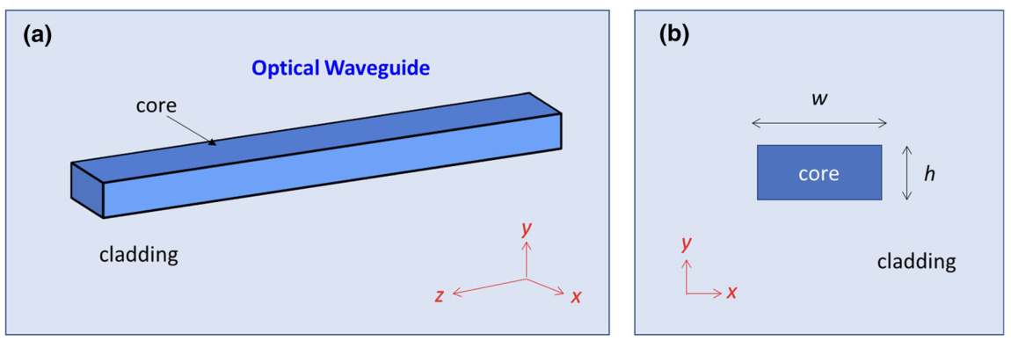
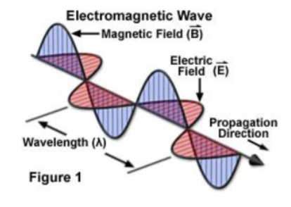
Optical waveguide
Two modes:
TE(Transversal Electric): Ex
TM(Transversal Magnetic): Ey

Slide 6
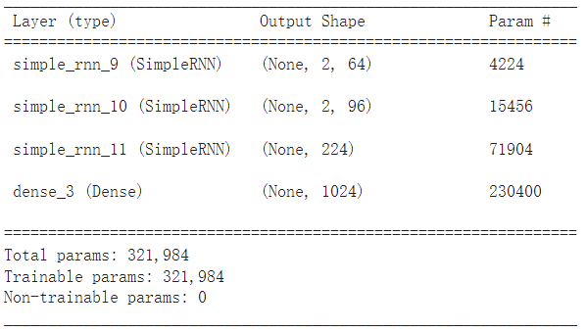
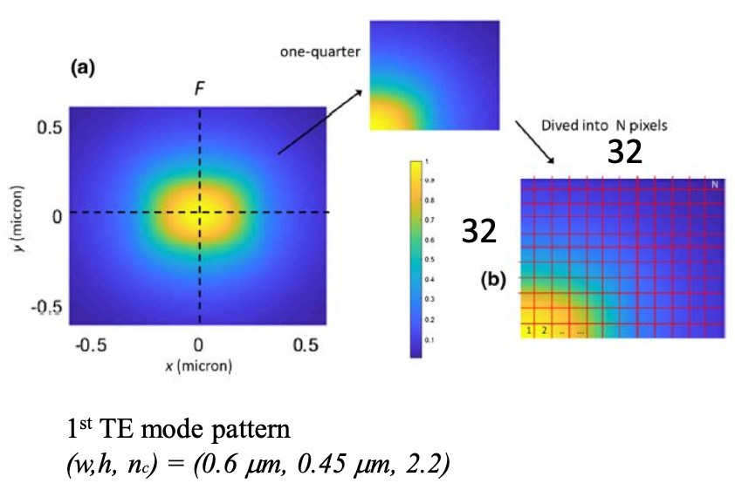
Research Part Analyze the electric field pattern of the rectangular optical waveguide.
RNN model summary

Slide 7
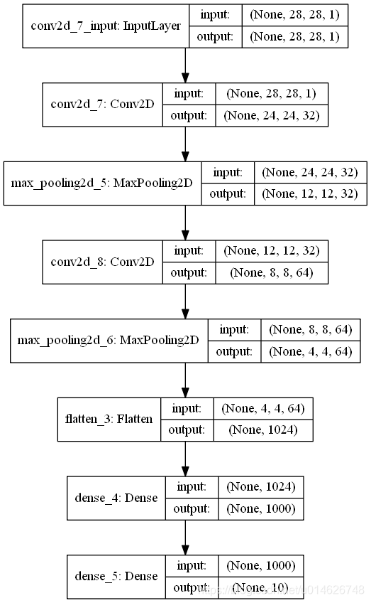
Building the CNN model
Here is the code implementation:
1) Load the dataset from .mat file
2) Data preprocessing:
• Shuffle all the data
• Reshape the input data 3) Build the RNN
4) Compile the RNN
5) Train the model
6) Evaluate the model
7) Comparison between the ground truth and prediction
2

Slide 8
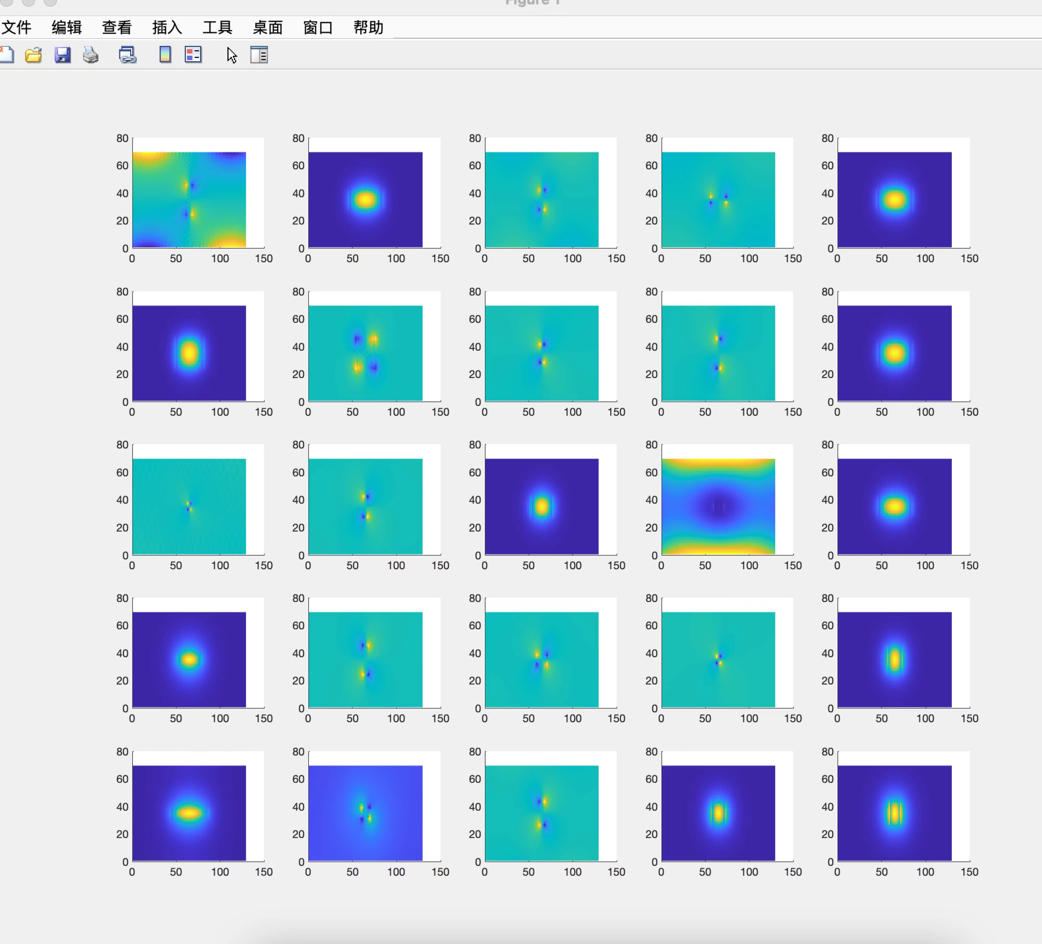
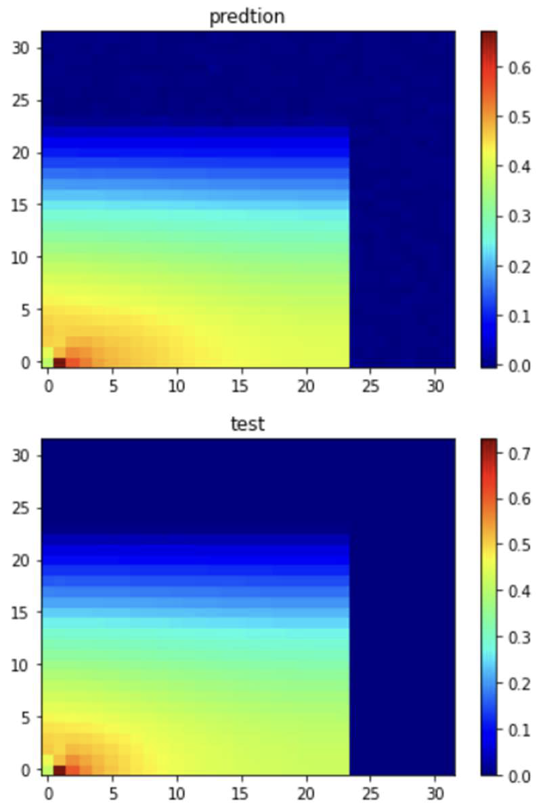
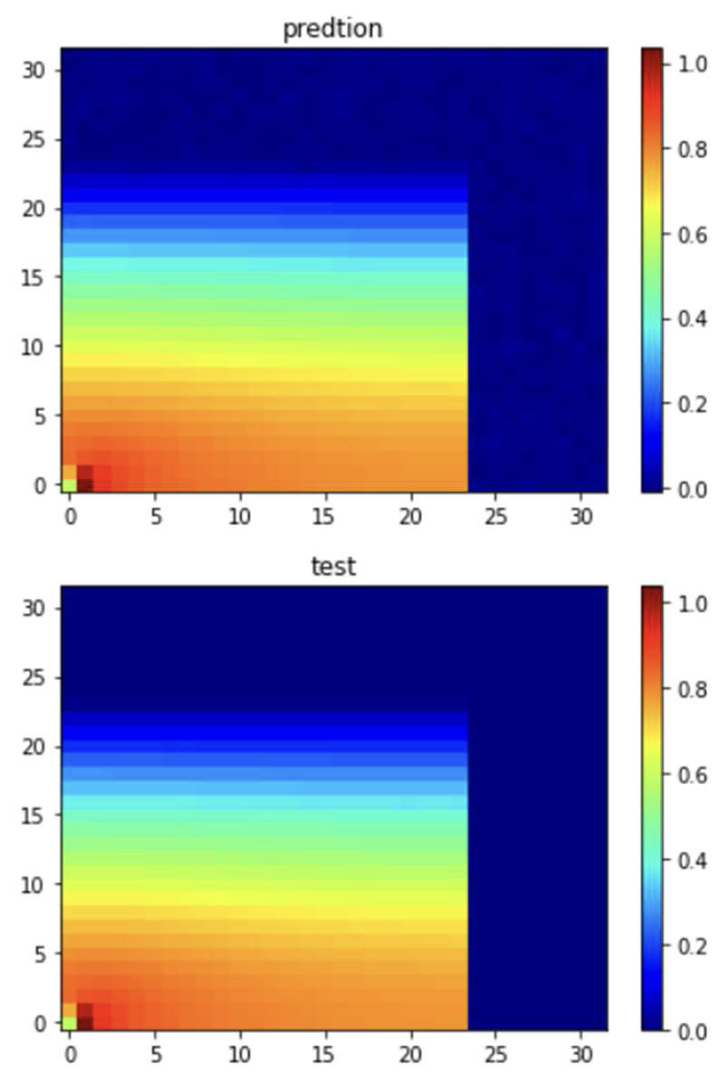
Dataset
One quarter of the field pattern
25 images randomly picked from dataset
Sample dataset: 2500 samples (1600 samples for training, 500 for testing, and 400 for validation)
Dataset for prediction: 12k

Slide 9
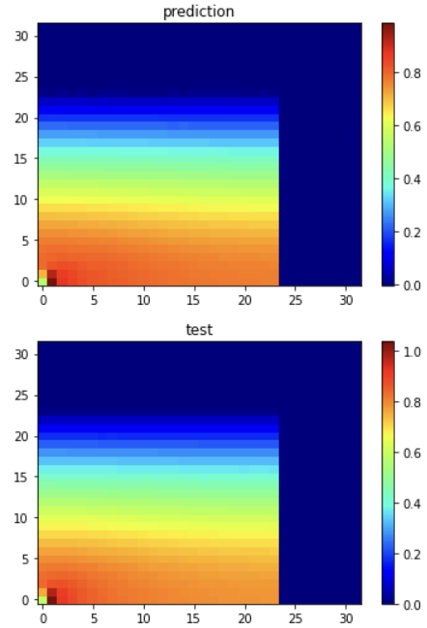
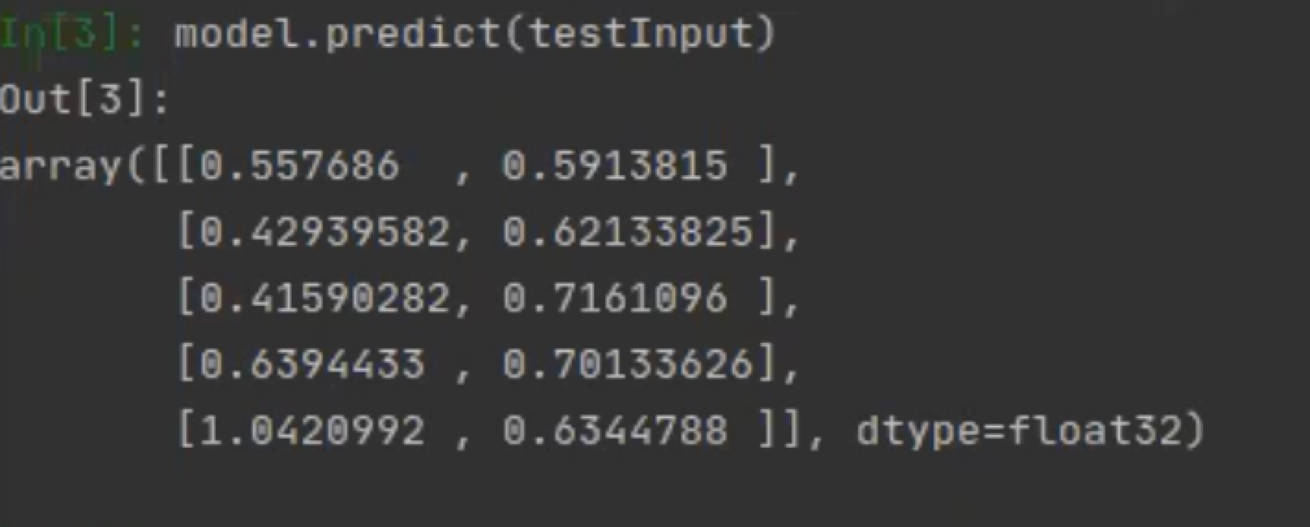
Evaluation
I used L2-norm and MSE to evaluate the difference between predictions and ground truths.
The L2-norm of field pattern is 0.00796.
And the MSE score of the width and height is 0.0559.

Slide 10
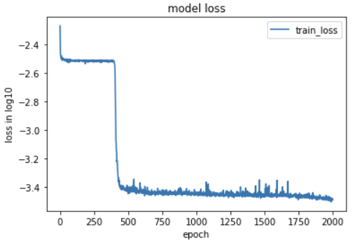
Result
Training loss of RNN model (epoch = 2000)
Training and Validation loss curve of CNN (epoch = 500)

Slide 11
Conclusion and future work
The prediction from deep learning models could approximate the ground truth but spending less time than calculating from Maxwell equation. With these two models, I have built a connection between field pattern and parameters of waveguide, which can be applied to different optical areas and devices.
The future work will focus on enhancing the performance of the CNN prediction by increasing the complexity of the network, such as increasing the number of neurons and layers, prediction on integration of 2 inputs and applying other deep learning algorithms on prediction.

Slide 12
Timeline
Time | Plan
Oct 20 | Search information and documents.
Oct 27 | Pre-processing datasets.
Oct 30 | Prepare slides.
Nov 3 | Presentation.
Nov 9 | Proposal.
Nov 20 | Analyze RNN model on prediction of field patterns.
Nov 25 | Build CNN model to predict the parameters.
Dec 4 | Finish training and testing.
Dec 12 | Final project presentation slide.
Dec 18 | Sort code and project paper.

Slide 13
Reference
Wei Ma, Zhaocheng Liu, Zhaxylyk A Kudyshev, Alexandra Boltasseva, Wenshan Cai, and Yongmin Liu. Deep learning for the design of photonic structures. Nature Photonics, 15(2):77–90, 2021.
Chapter 9, 9.1-9.3 of Deep Learning Book
Procedia Computer Science 132(2018)377-384 “An Analysis Of Convolutional Neural Networks For Image Classification”.
Szegedy, C., Liu, W., Jia, Y., Sermanet, P., Reed, S., Anguelov, D.,&_Rabinovich, A.(2015) “Going deeper with convolutions.” in Proceedings of the IEEE conference on computer vision and pattern recognition (pp. 1-9).
C. M. Chew and W. H. Weedon, “A 3d perfectly matched medium from modified Maxwell’s equations with stretched coordinates”, Microwave and Optical Tech. Lett., vol. 7, No. 13, pp. 599-604, 1994
Alagappan, G.; Ong, J.R.;Yang, Z.; Ang, T.Y.L.; Zhao,W.; Jiang,Y.; Zhang,W.; Png, C.E. Leveraging AI in Photonics and Beyond. Photonics 2022, 9, 75. https://doi.org/10.3390/photonics9020075
https://pyimagesearch.com/2019/02/04/keras-multiple-inputs-and-mixed-data/
AI4D Proposal: Deep learning optimization of frequency microcomb

